Slide 1
BOX

Slide 2
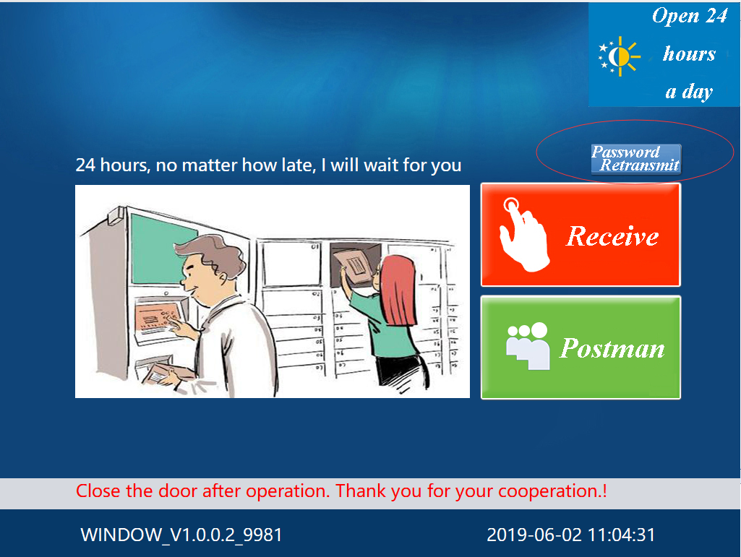
Function 1: Password Retransmit

Slide 3
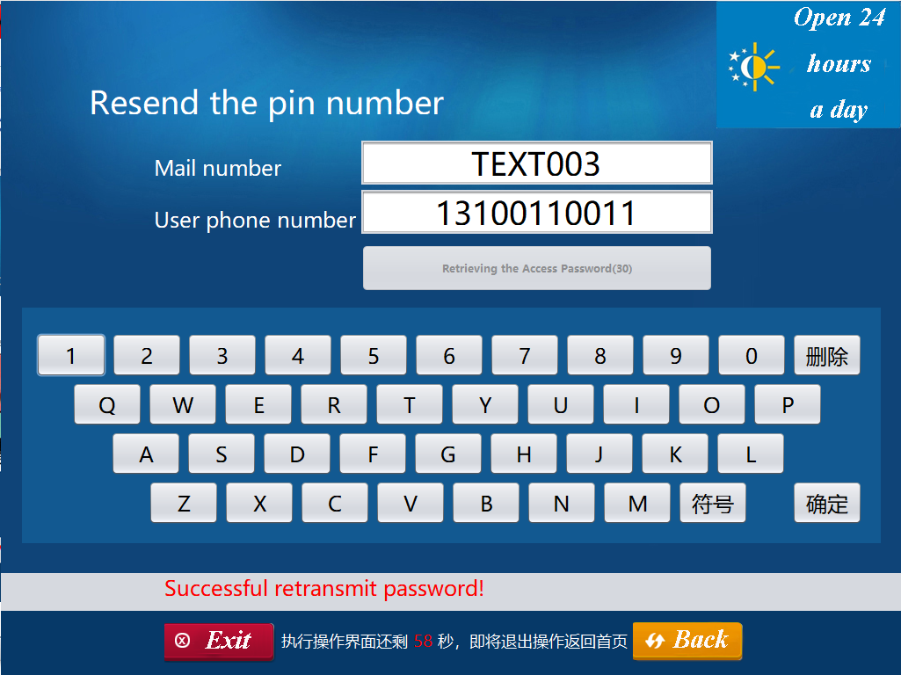

Slide 4
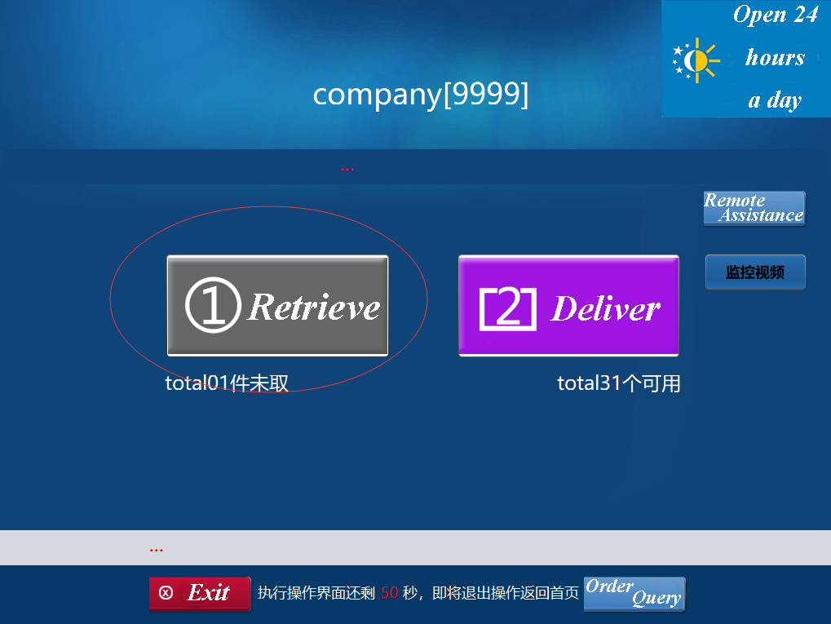
Function 2: Retrieve

Slide 5
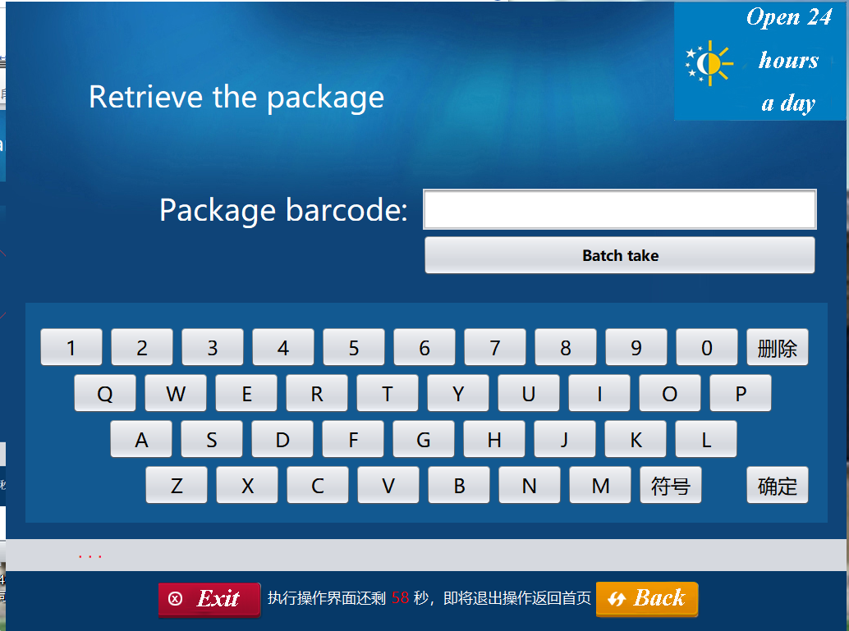

Slide 6
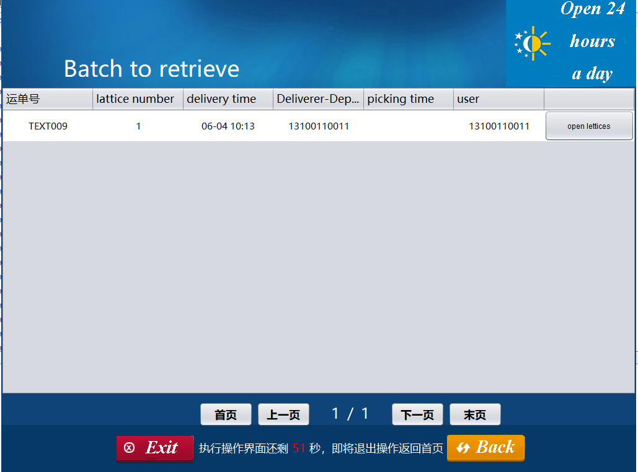

Slide 7
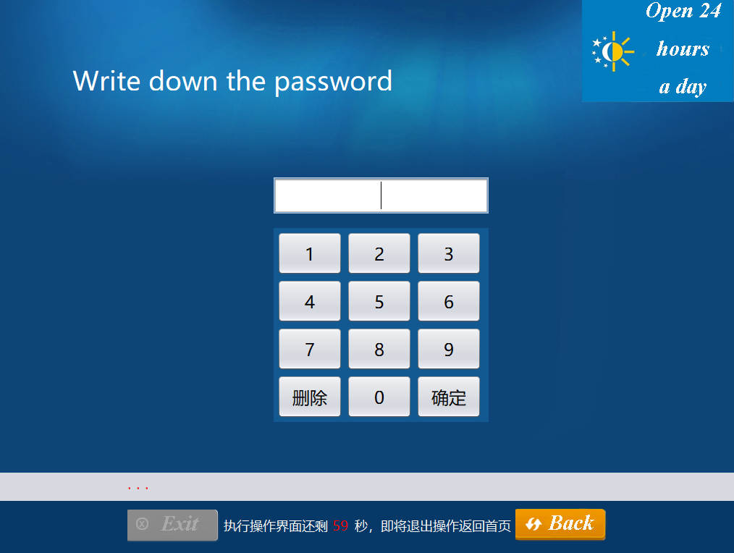

Slide 8
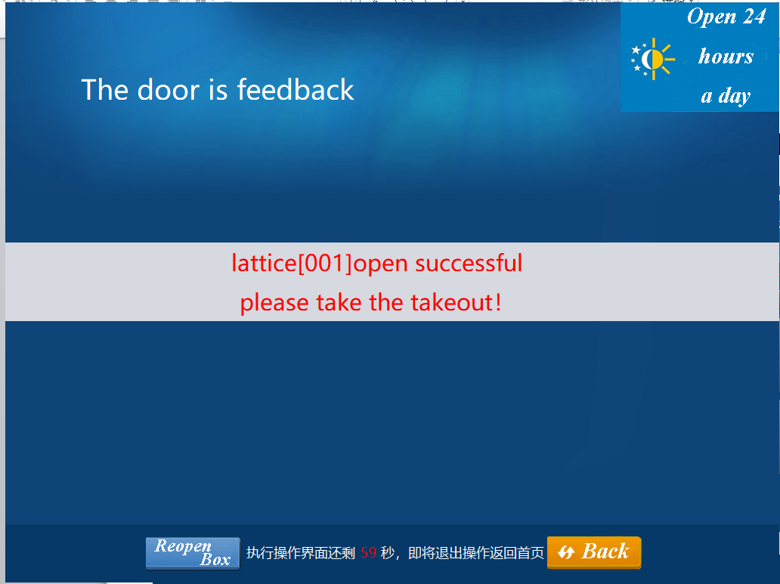

Slide 9
Function 3: Courier order inquiry
Ivy

Slide 10
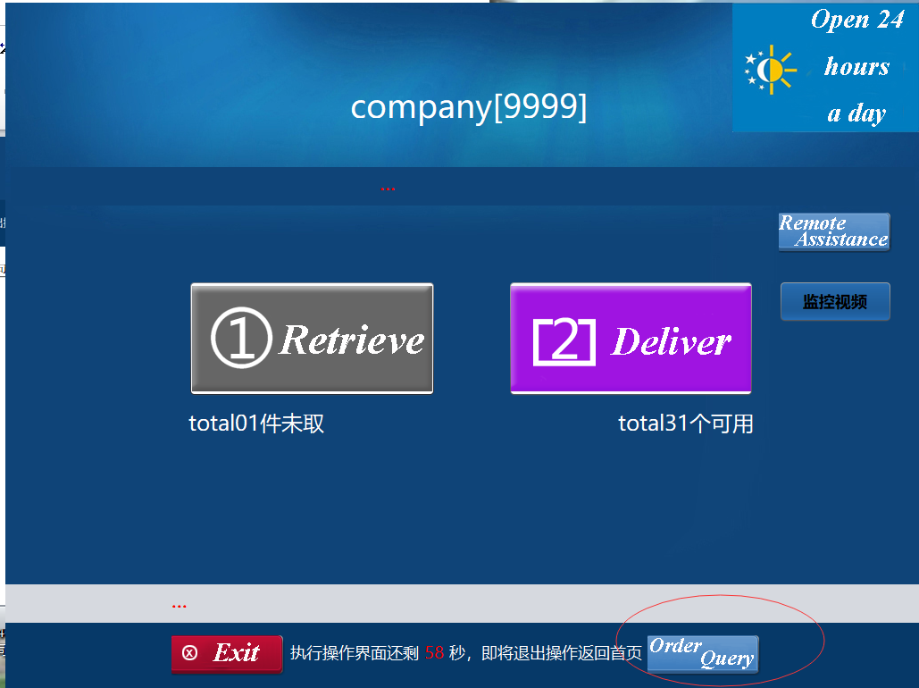
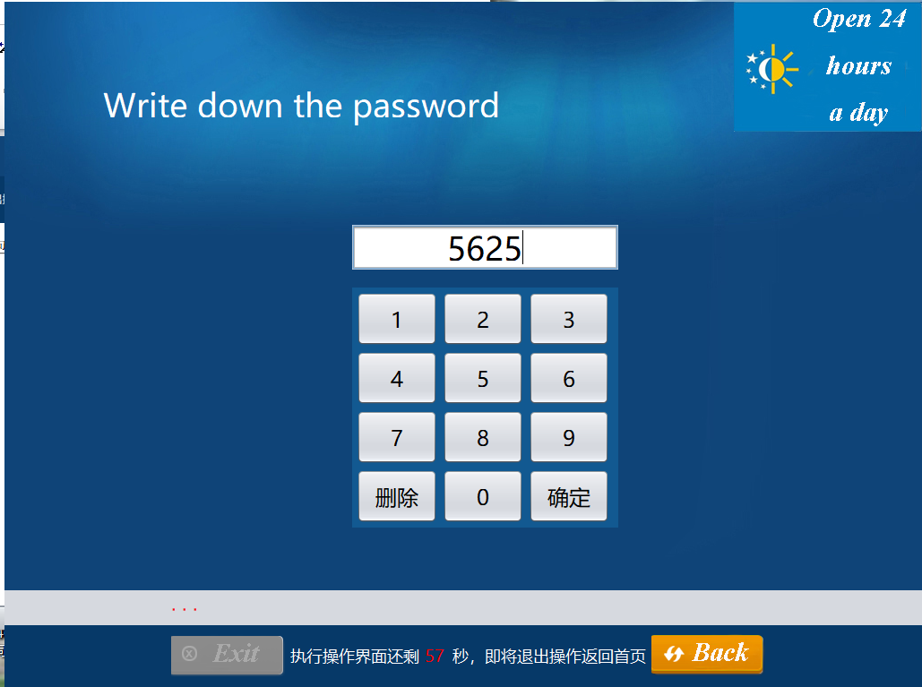
Courier delivery page

Slide 11
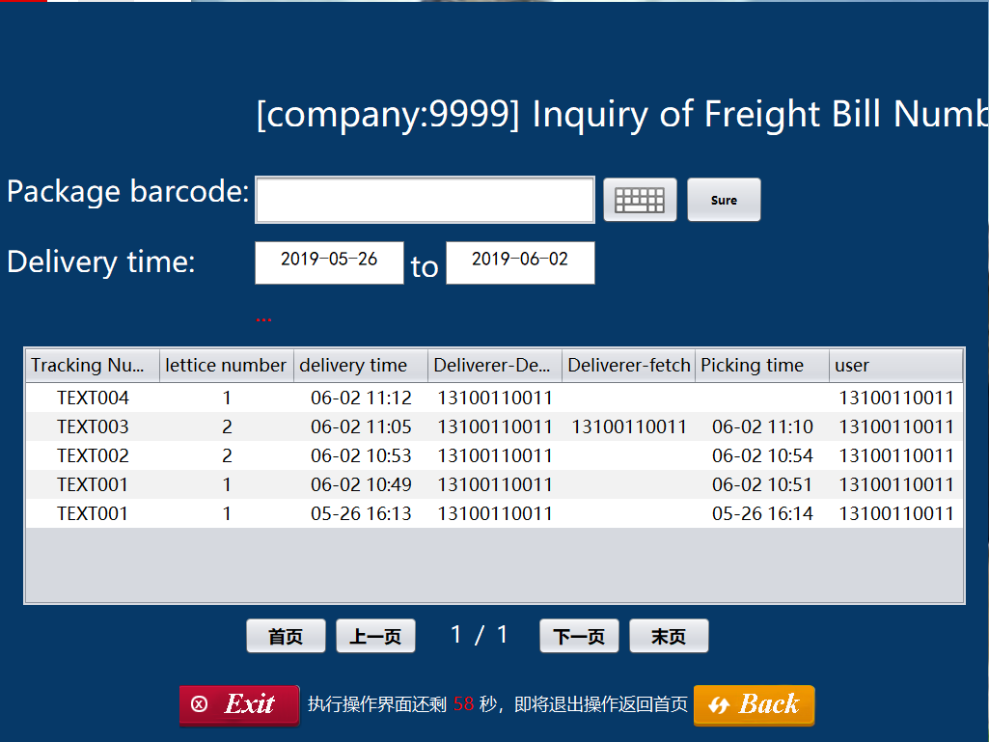
Courier Parcel Inquiry Page
This function can query the details of all delivery orders.
The courier can find the delivered package on time.
This function facilitates the statistical management of the system.
If the package is lost, the customer can also find the corresponding courier conveniently.

Slide 12
Function 4: REMOTE ASSISTANCE
Kathy

Slide 13
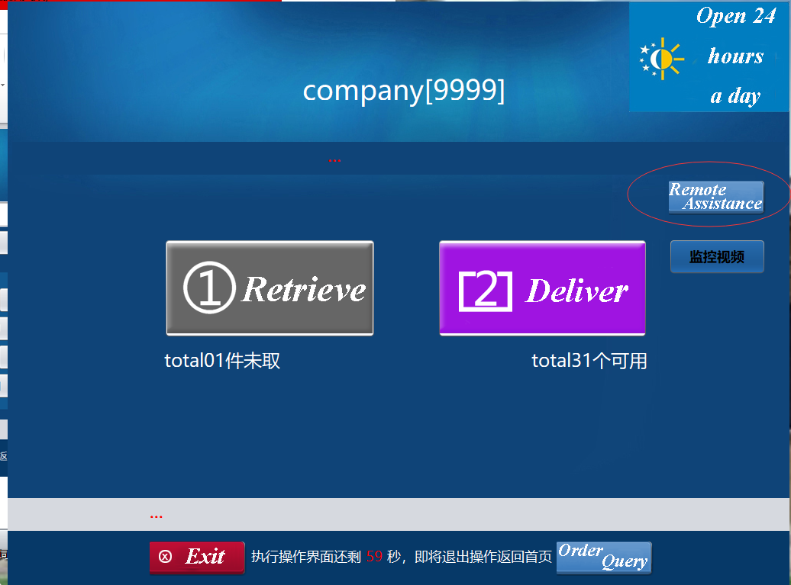
REMOTE ASSISTANCE
Retrieve: The cabinet used to save the courier.
Deliver: Replaceable cabinet
Click “Remote Assistance” submit error

Slide 14
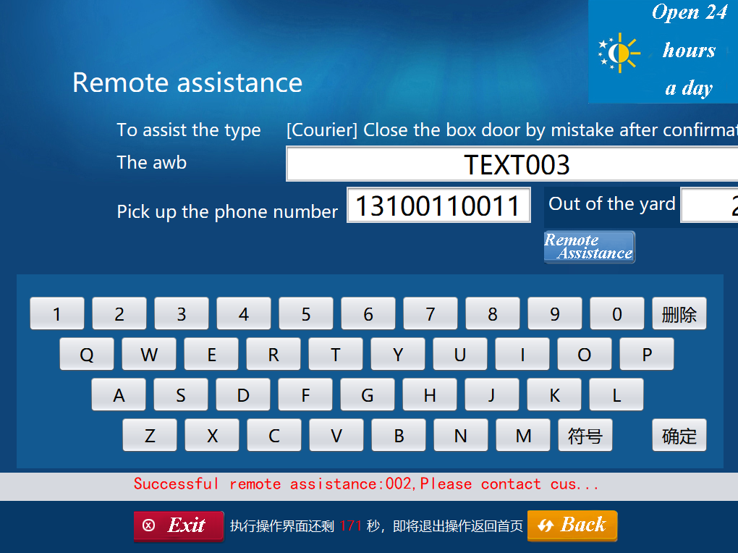
Remote assistance page
Enter the tracking number
Enter the phone number

Slide 15
Function 5: Re-select the cabinet
Anna Zhang

Slide 16
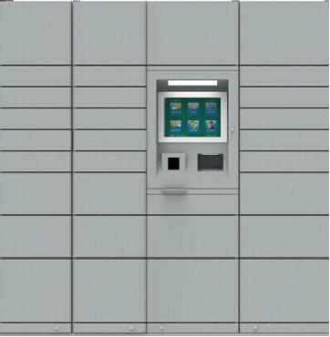
Box
1.This is our concept picture of the physical cabinet.
2.Cabinet size is divided into large, normal and small.
3.The computer control the cabinets and connected to the background.

Slide 17
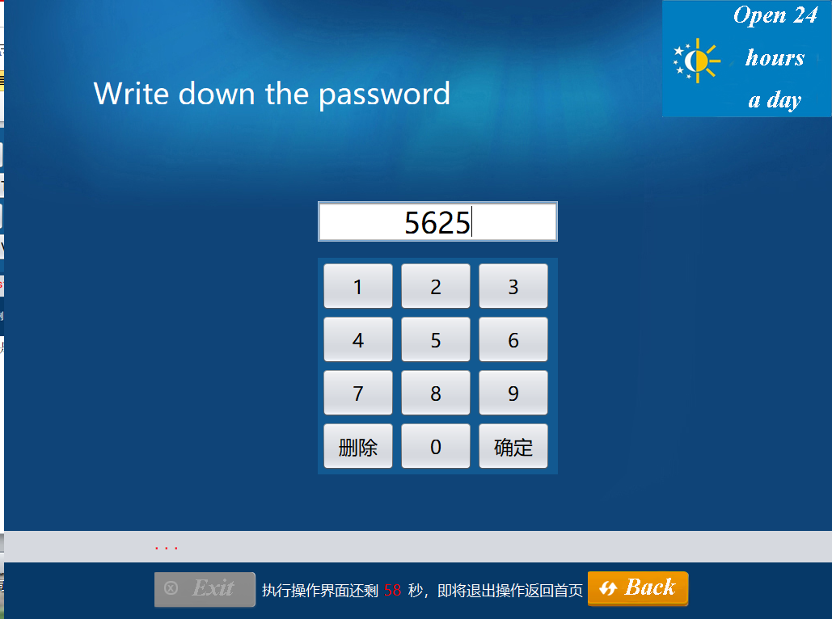
Re-select the cabinet
When the courier finds that the size of the cabinet does not correspond to the item, he can choose the appropriate cabinet to save.

Slide 18
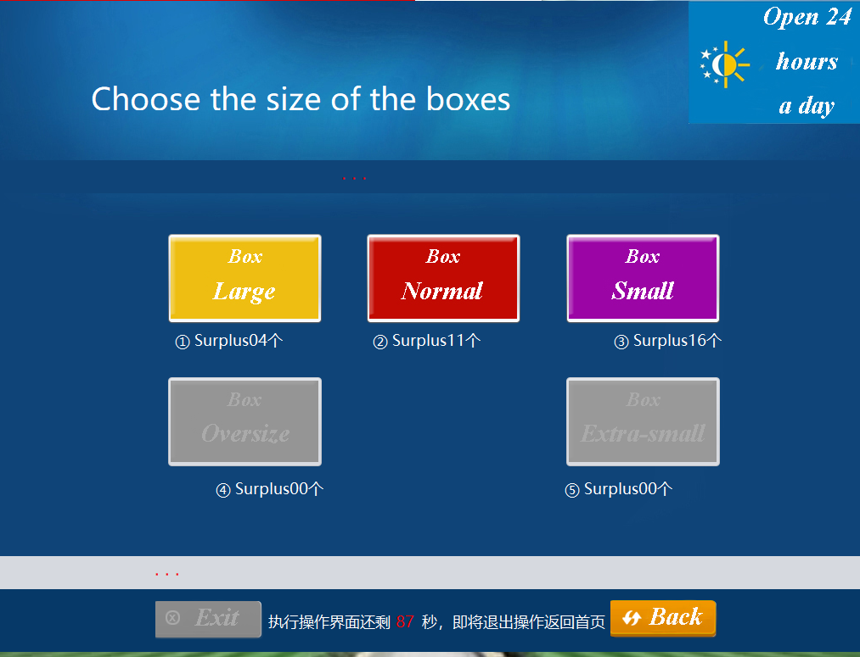
Choose the size
It has three sizes of cabinets to choose from.
Large Box
Normal Box
Small Box

Slide 19
Function 6: Error reporting mechanism
Olivia

Slide 20
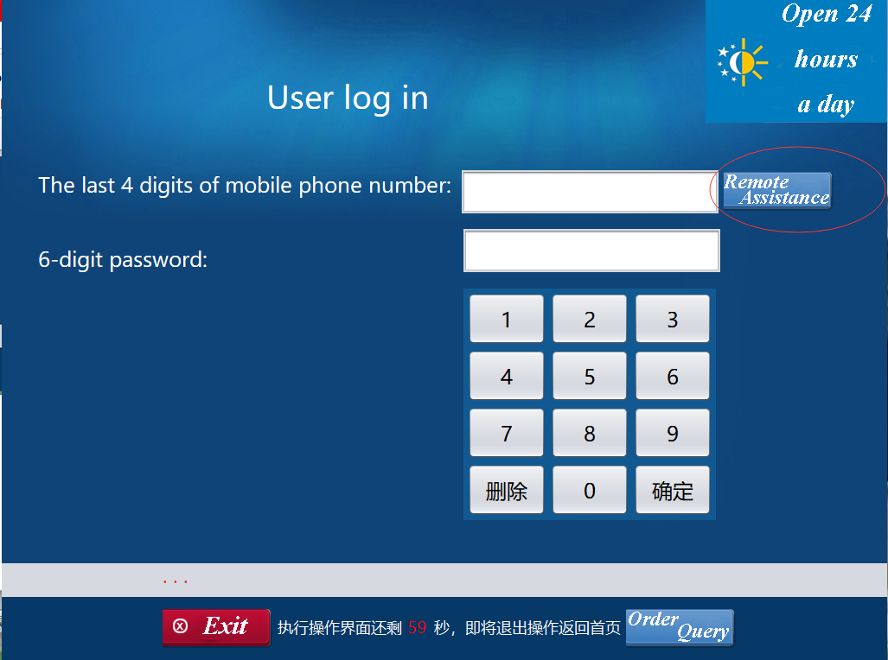
Error Reporting Mechanism
· This function is a repair function, when people use the box and find that the cabinet door cannot be closed or other problems need remote assistance

Slide 21
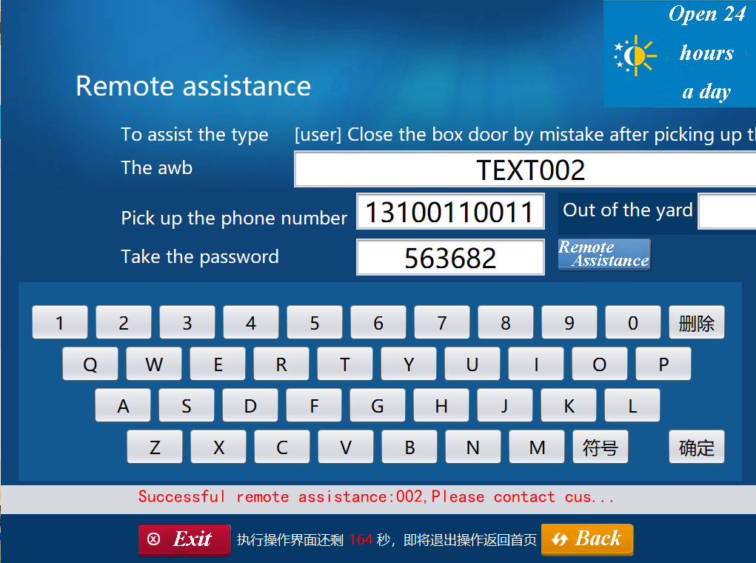
Error Reporting Mechanism
·People submit their user information, order information to the background
This function is a repair function, when people use the box and find that the cabinet door cannot be closed or other problems need remote assistance

Slide 22
Function 7: Receiver order inquiry
Bruce

Slide 23
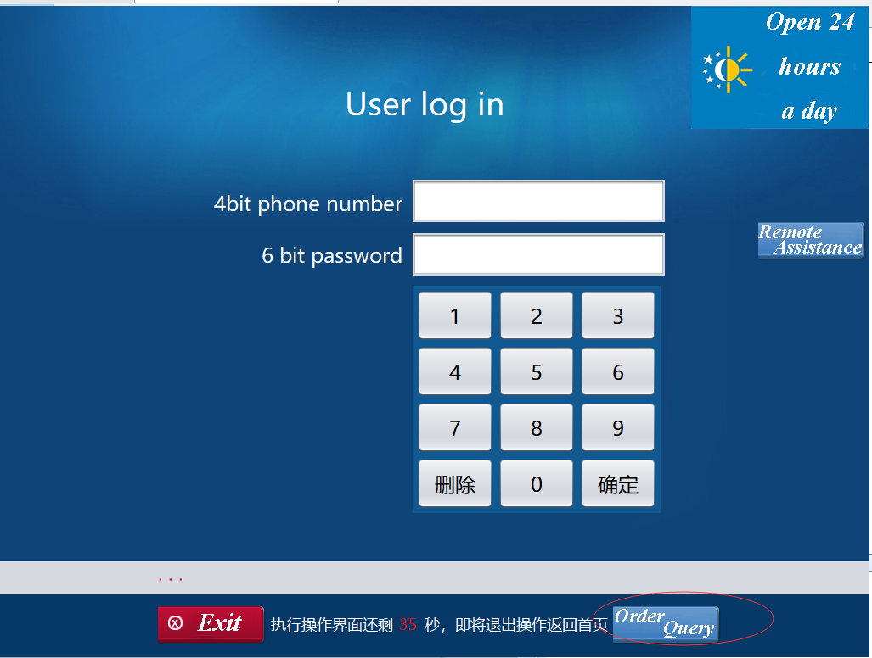
Receiver Order Inquiry

Slide 24
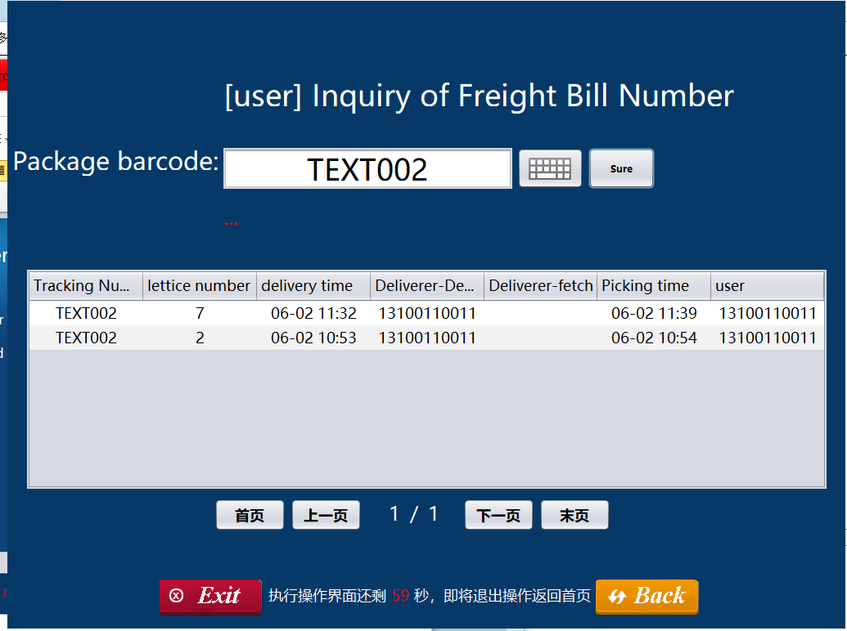
Receiver Order Inquiry
This function is used to query all receiving records of the receiver. Click the “Receive” button on the home page to enter the receiver's interface. Then clink “Order Query” to check his record of taking parts. After entering the Package barcode, the receiver can browse all the details of the order.

